Slide 1
INTRODUCTION TO MACHINE LEARNING CLASSIFCATION Foster Mensah fmensah@ug.edu.gh Centre For Remote Sensing and Geographic Information Services (CERSGIS)
Accra, Ghana
September, 2021

Slide 2
Machine Learning
Machine learning focuses on the development of computer programs that can access data and use it to learn for themselves
The main objective is to ‘train’ computers to learn automatically without human intervention
The training process begins with observations or data, in order to look for patterns in the data
The trained model becomes the basis for predicting future patterns based on new data
Machine learning enables analysis of very large volumes of data

Slide 3
Machine Learning Methods
Machine learning methods or algorithms are often categorized as supervised or unsupervised
Supervised algorithms use labeled examples to predict future events based on new data
The predicted output can be compared with a correct output to assess the accuracy of the model
Unsupervised algorithms use unlabeled data to determine patterns
They do not figure out the right output, but rather explores the data to identify hidden patterns from unlabeled data

Slide 4
Supervised algorithms
The two primary machine learning algorithms for supervised image processing are:
Random forest (RF)
Support Vector Machine (SVM)
RF works great with sparse data
Performs better than image segmentation (the process of partitioning an image into a set of non-overlapping regions) with histogram-based approaches
It is a collection of decision trees

Slide 5
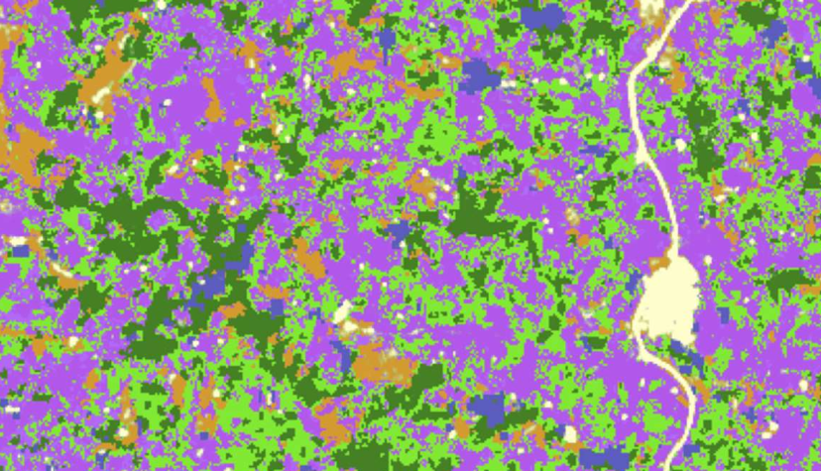
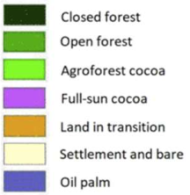
Decision Tree
Pixel Value
<80
>122
91-100
CF
105-120
85-90
ST
LIT
OP
OF
Root node
Internal node
High
Low
Leaf node
AFC
FSC
All branches should end in a leaf node
A decision tree is considered trained when all branches end in leaf node
The disadvantage of a classical decision tree algorithm is overfitting (i.e. low accuracy), thus RF
RF is a collection of decision trees

Slide 6
Random Forest
Segments data into clusters
Does not require labeled data
Pre-training activity is not required
The primary machine learning algorithms for unsupervised classification:
K-Means
Gaussian Mixture Model

Slide 7
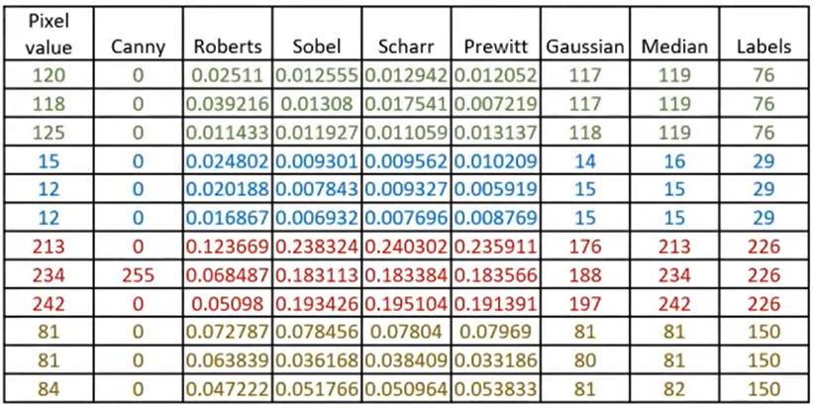
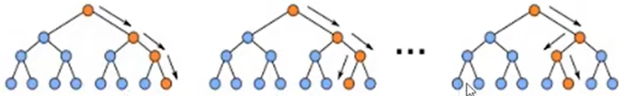
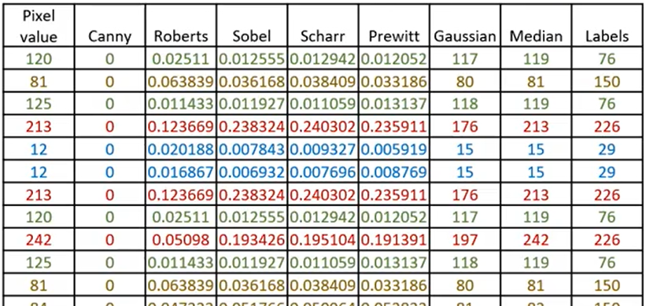
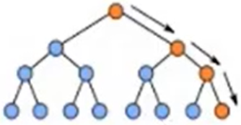
Random Forest
Input data
Collection of decision trees
Closed Forest
Open Forest
Full Sun Cocoa
Not included in training
Random subset of features available
Pick a feature that provides the best split
Random subset of features available
Bootstrapped data
(uses two-thirds of the data)
Random subset of features available
Note: Accuracy assessment is an important step in the process

Slide 8
Prediction and Accuracy Assessment
Final prediction is determined by majority voting
majority
voting
final
prediction
Use one-third of the data that never got used in building the RF model is set aside to test the model’s accuracy

Slide 9
Summary
Step 1: The algorithm selects random samples from the dataset provided
Step 2: Creates a decision tree for each sample selected, and predicts a result from each decision tree created
Step 3: Performs voting for every predicted result to determine the final prediction
Step 4: Finally, the algorithm selects the most voted prediction result as the final prediction.

Slide 10
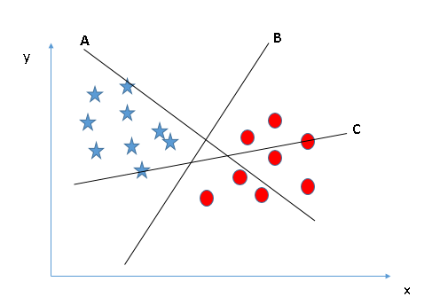
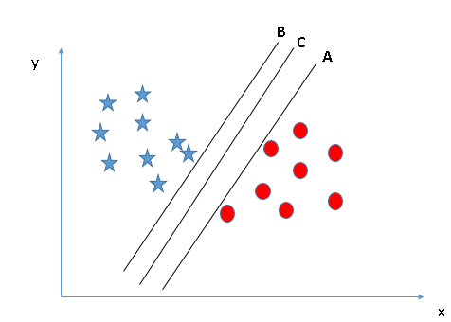
Support Vector Machine
It is a supervised machine learning algorithm
Support Vectors are the co-ordinates of individual observation
Support Vector Machine is a straight line which best segregates observations into unique classes
However, how can we identify the right line

Slide 11
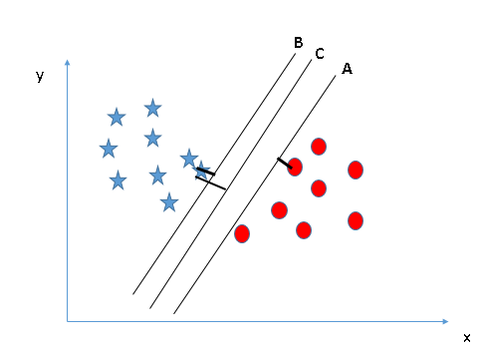
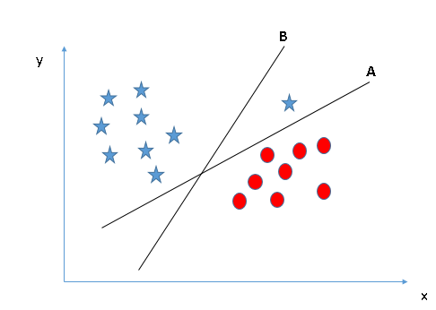
Identifying the line with the maximum distance (i.e. margin) between nearest data point
Usually, we do not find a straight ‘line’ which segregates the classes
In such cases, the observations are mapped on a transformed scale so that they get segregated from each other

Slide 12
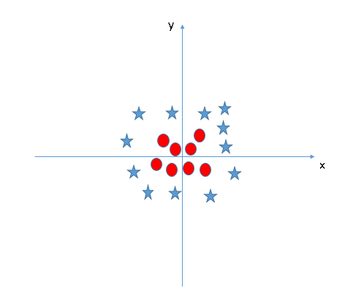
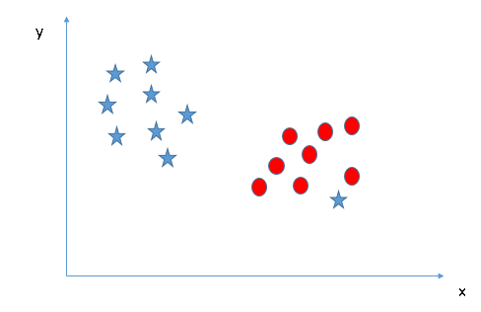
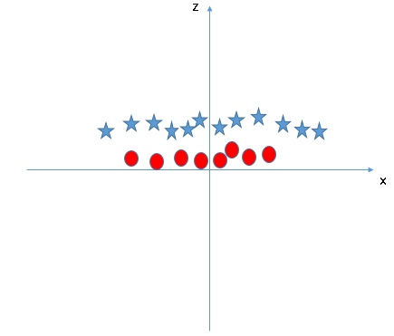
Z = X² + Y²

Slide 13
Unsupervised classification algorithms
Segments data into clusters
Does not require labeled data
Pre-training activity is not required
The primary machine learning algorithms for unsupervised classification:
K-Means
Gaussian Mixture Model

Slide 14
K-Means algorithm
An Iterative algorithm that divides a datasets into K subgroups or clusters based on the similarity and their mean distance from the centroid of a particular subgroup
Randomly picks centroids
Calculated the distance from each centroid
Base on the distance of a data point to a centroid the data point is assigned to a particular centroid

Slide 15
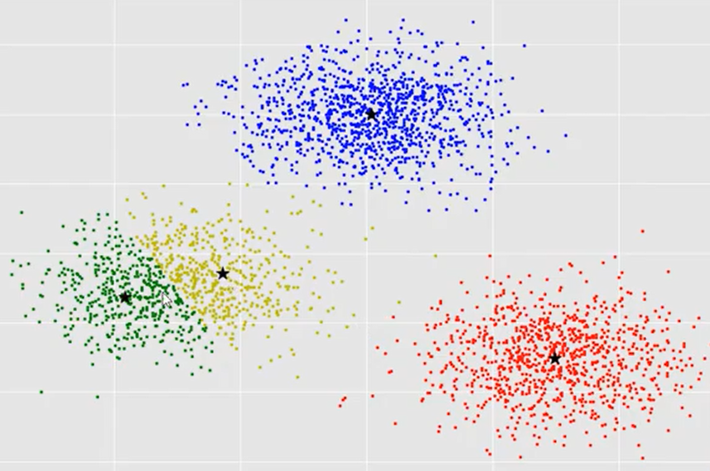
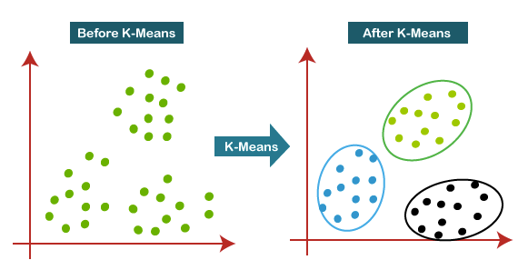
K-Means algorithm

Slide 16
Summary
Step-1: Select the value of K, to decide the number of clusters to be formed
Step-2: Select random K points which will act as centroids
Step-3: Assign each data point, based on their distance from the randomly selected points (centroid), to the closest centroid
Step-4: place a new centroid of each cluster
Step-5: Repeat Step-3 to reassign each data point to the new closest centroid of each cluster
Step-6: If any reassignment occurs, then go to step-4 else stop

Slide 17
Gaussian Mixture Model (GMM) algorithm
Gaussian mixture models can be used to cluster unlabeled data in much the same way as k-means
There are however, a couple of advantages to using Gaussian mixture models over k-means:
K-means does not account for variance (i.e. the width of the bell shape curve)
K-means performs hard classification whereas GMM performs soft classification (i.e. k-means tells what data point belong to which cluster but does not provide the probabilities that a given data point belongs to each of the possible clusters.

Slide 18
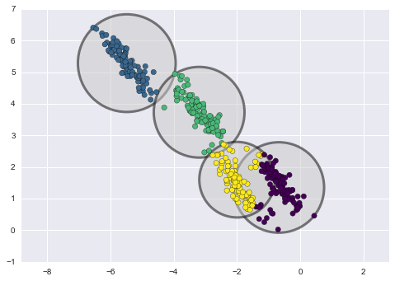
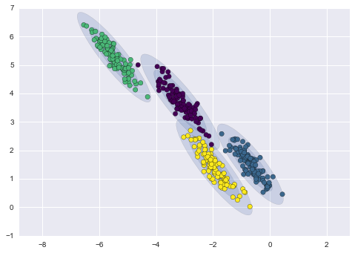
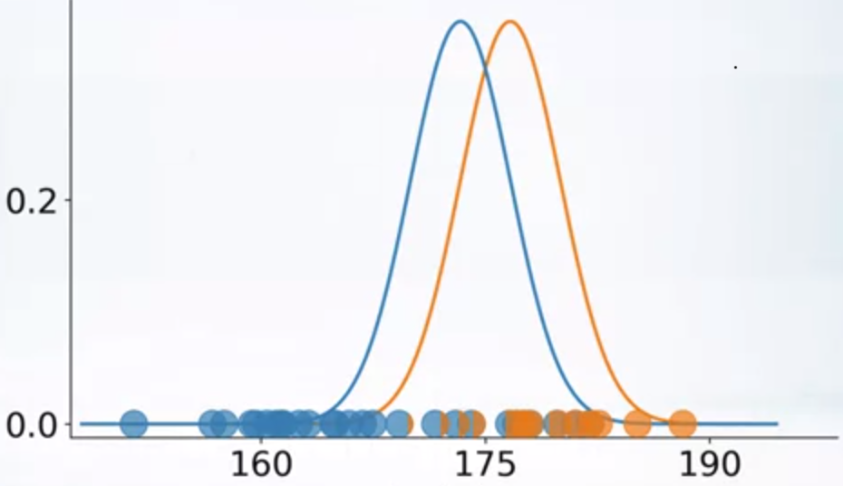
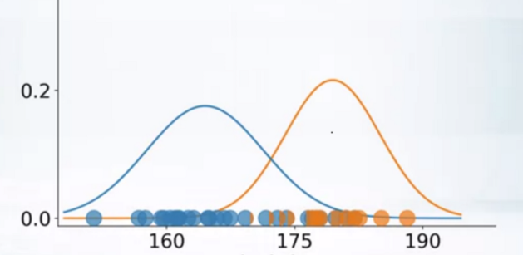
Gaussian Mixture Model Explained
This Involves the mixture of multiple Gaussian distributions
Not knowing what samples represent a particular class, the goal is to use Gaussian Mixture Models to assign the data points to the appropriate cluster
Every distribution is multiplied by a weight π to account for differences in the number of samples from each class (the weights should add up to one since this is based on probabilities)

Slide 19
The model will determine the likelihood of an i^{th} sample coming from Gaussian k, based on the mean, covariance and weight for each Gaussian
In order to extend this to all samples in a given dataset:
we assume that the likelihood of observing respective samples are independent of all the others.
Then we can simply multiply them or take the log of the likelihood (because the multiplication of two numbers inside of a log is equal to the sum of the logs of its constituents)
The question then is, how do we go about selecting the optimal values for the variance and mean…………………. in a maximization step, which maximizes the likelihood that a sample came from a particular distribution

Slide 20
Machine Learning classifiers for land cover classification
Many land cover classification techniques used the Maximum Likelihood Classification (MLC)
Popular parametric classifier due to its excellent classification results
Parametric classifiers assume normal distribution of data
In real-world data do not follow normal distribution
Machine learning classifiers have emerged as powerful classifiers due to their higher accuracy and performance
Additionally, these non-parametric classifiers do not assume normal distribution of the data

Slide 21
Non-Parametric Machine Learning classifiers
The following classifiers provide highly good LULC classification results (Nery et al., 2016):
Random Forest (RF)
A favourite classifier for LULC (Gislason, Benediktsson, & Sveinsson, 2006)
Support Vector Machine (SVM)
Classification and Regression Trees (CART)
Has the tendency to over fit the model (Lawrence & Wright, 2001)

Slide 22




Thank You
Accra, Ghana
September, 2021
Notes:
It's free for non-commercial use!

Slide 23
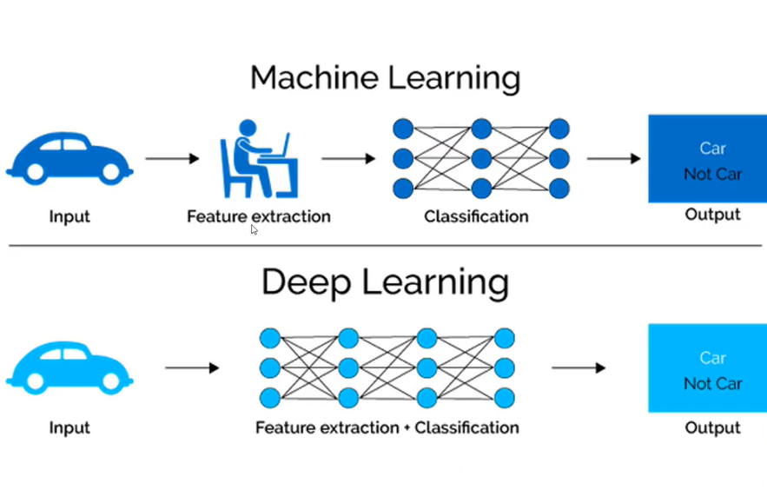

Slide 24
